Slide 1
The IEC 62443 was developed to secure industrial automation and control systems (IACS) throughout their lifecycle. It currently includes nine standards, technical reports (TR) and technical specifications (TS).
IEC 62443 was initially developed for the industrial process sector but IACS are found in an ever-expanding range of domains and industries, such as power and energy supply and distribution, and transport.
IEC 62443 addresses not only the technology that comprises a control system, but also the work processes, countermeasures, and employees. The standard takes a holistic approach because not all risks are technology-based: the staff responsible for an IACS must have the required training, knowledge and skills to ensure security.
The IEC 62443 series of standards is organized into four parts:
General
Part 1 covers topics that are common to the entire series:
1-1 (TS): Terminology, concepts and models
Policies and procedures
Part 2 focuses on methods and processes associated with IACS security:
2-1: Establishing an IACS security program
2-2: Security Protection Rating.
2-3 (TR): Patch management in the IACS environment
2-4: Security program requirements for IACS service providers

Slide 2
System
Part 3 is about requirements at the system level:
3-1: Security technologies for IACS
3-2: Security risk assessment for system design
3-3: System security requirements and security levels
Components and requirements
Part 4 provides detailed requirements for IACS products:
4-1: Secure product development lifecycle requirements
4-2: Technical security requirements for IACS components

Slide 3
IEC 62443-1-1 presents the concepts and models of the series
The technical report 62443-1-2 contains a glossary of terms and abbreviations used throughout the series.
The standard 62443-1-3 describes a series of metrics derived from the basic requirements (FR) and system requirements (SR).
IEC 62443-2-1 describes what is required to define and implement an effective IACS cyber security management system.
The standard 62443-2-2 provides specific guidance on what is required to operate an effective IACS cyber security management system.
Technical Report 62443-2-3 provides guidance on the specific topic of patch management for IACS.
Standard 62443-2-4 specifies requirements for suppliers of IACS

Slide 4
The technical report 62443-3-1 describes the application for different safety technologies to an IACS environment
The standard 62443-3-2 addresses the risk assessment and the system design for IACS.
The IEC 62443-3-3 gives a series of technical controls that you should be able to implement inside your industrial control system to help protect that control system against the adversary that you are particularly worried about
IEC 62443-4-1 is about processes that and procedures that organization need to follow as a creator of that control systems security to ensure that the security is effective and it does not have those sorts of vulnerabilities that can allow organization security to be bypassed secured design of a product or a system is an absolutely critical piece to the overall security puzzle.
IEC 62443-4-2 contains requirements, which allow a detailed mapping of the system requirements (SR) to subsystems and components of the system under scope.
The probability of an impact looked into like means, motive and opportunity. Means and motive are things that are very hard for an asset owner to control but opportunities is something that the asset owner has a whole lot of control over and if we can suggest ways of mitigating the opportunity for somebody to perform an action that has a significant impact to the asset owner.

Slide 5
Topics covered by Policies and Procedures
There are several topics that policies and procedures can cover. Every organization its different and should determine the appropriate policies and procedures that are applicable for its industrial automation and control systems. Possible topics include:
Risk Management
Access Management
Availability and Continuity planning
Physical Security

Slide 6
Architecture that includes secure configurations of control systems including such issues as :
Recommended network designs, recommended firewall configuration, user authorization and authentication, interconnecting different process control networks, use of wireless communications, domains and trust relationships, patch management, anti-virus management, access to external networks and appropriate use of email.
Portable Devices
Wireless Devices and Sensors
Remote Access
Personnel
Subcontractor Policy
Auditing
Security Policy updating
Training

Slide 7
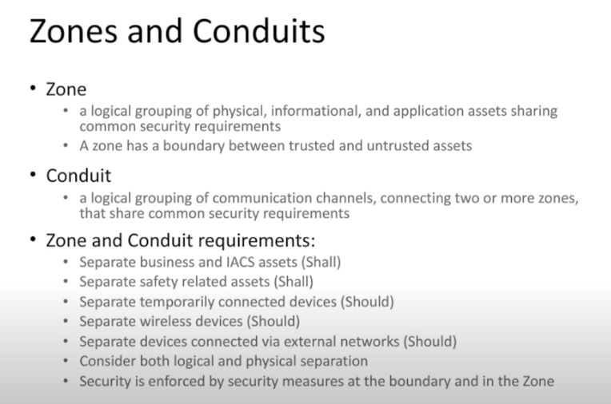

Slide 8
Standards Benefits
Easy to define a target security level
Offers a frame of reference to evaluate existing security
Clear understanding of security requirements
Simple to define a system security capability
Simple to define a product security capability
Easy to differentiate from competitors

Slide 9
Security practices documented in standards
Security Management (SM)
Specification of Security Requirements (SR)
Secure by Design (SD)
Secure Implementation (SI)
Security verification and validation testing (SVV)
Management of security related issues (DM)
Security update management (SUM)
Security Guidelines (SG)

Slide 10
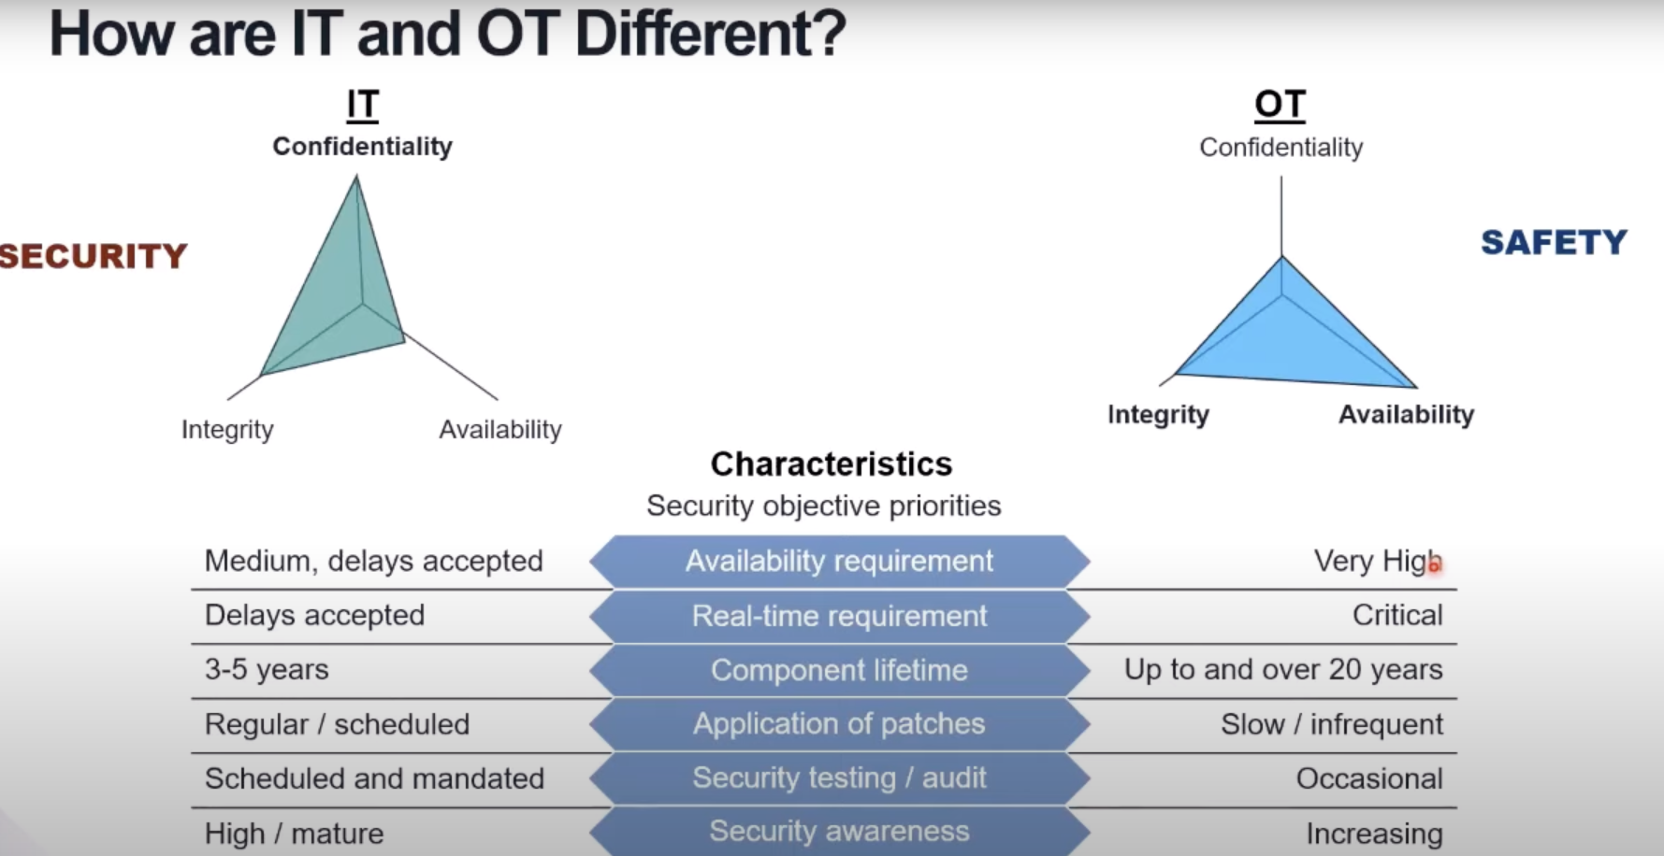

Slide 11
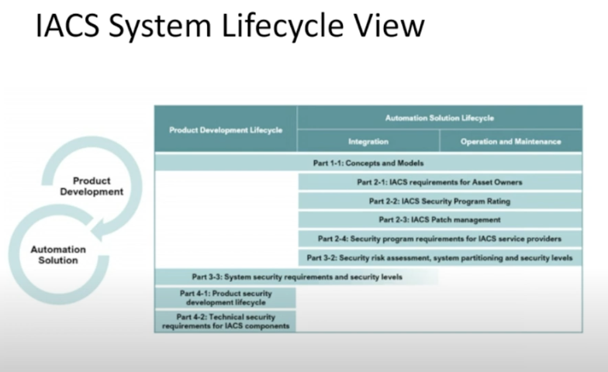

Slide 12
The goal in the standards committee is to provide that bridge effectively here’s these foundational principles of industry of information security and information insurance and here’s a encapsulation of how you would apply those foundational principles to a specific industrial control system or railway system or anything.
Standards leave room for two things to happen
Stating goals that are hopefully not going to change significantly over the course of at least a decade
Leaving room for various product suppliers and asset owners to innovate in how they actually address the problems

Slide 13
FR’s The 7 Foundational Requirements applied to endpoints
The IEC 62443 series provides detailed technical control system requirements (SRs) associated with the seven foundational requirements (FRs) described in IEC 62443-1-1 including defining the requirements for control system capability security levels, SL-C(control system). These requirements would be used by various members of the industrial automation and control system (IACS) community along with the defined zones and conduits for the system under consideration (SUC) while developing the appropriate control system target SL, SL-T(control system), for a specific asset.
Identification and authentication control (IAC):
Manage authorized users and accounts and access to the system
Use control (UC):
Enforce the assigned privileges of an authenticated user to perform the requested action on the IACS and monitor the use of these privileges
System Integrity (SI):
Protect from malware, vulnerabilities, insecure code etc..

Slide 14
Data Confidentiality (DC):
Ensure the confidentiality of information on communication channels and in data repositories to prevent unauthorized disclosure Application whitelisting, etc..
Restricted data flow (RDF):
Protect endpoints from insecure ports, services, and other communication paths
Timely response to events (TRE):
Monitor endpoints for security events (logs, user, behavior, performance, communications, file creation, etc. And respond quickly
Resource availability (RA):
Ensure the availability of the control system (eg, backups, redundancy, securing availability risks and vulnerabilities etc.

Slide 15
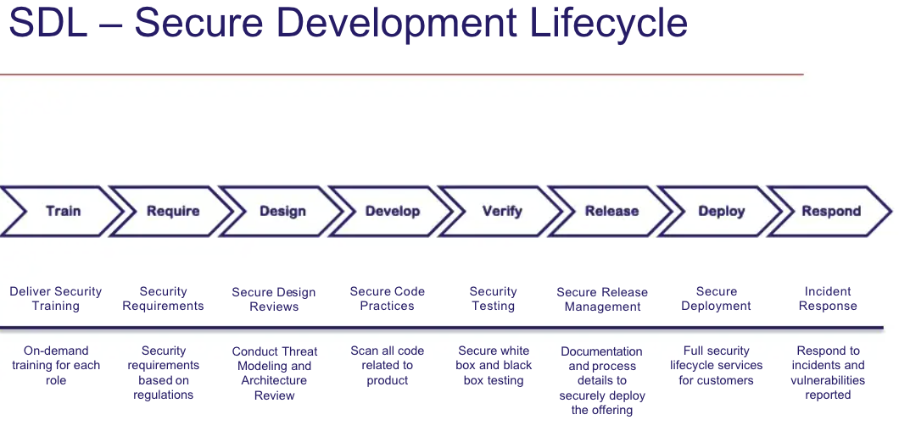

Slide 16
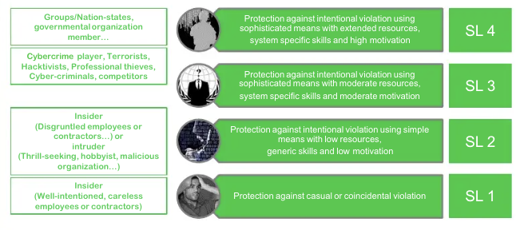
Organizations may try to use pre-existing IT and business cyber security solutions to address security for IACS without understanding the consequences. While many of these solutions can be applied to IACS, they need to be applied in the correct way and with cognizance of their side-effects to eliminate or reduce inadvertent consequences.
IEC 62443 Security Assurance Levels:
Security levels define the cybersecure functions embedded in our products, it increase the product robustness and make it resistant to the cyber threats.

Slide 17
IEC 62443 principal roles
the IEC 62443 standard identifies 3 different stakeholders involved in product security:
The asset owner is the organization that is accountable and responsible for the IACS. The asset owner is also the operator of the IACS and the equipment under control (EUC).
Integration service provider is the organization that provides integration activities for an automation solution including design, installation, configuration, testing, commissioning and handover to the asset owner. The integration service provider may also facilitate the risk assessment.
Product supplier is the organization that manufactures and supports a hardware and/or software product. Products may include IACS systems and IACS components such as embedded devices, host devices, network devices and/or software applications.

Slide 18
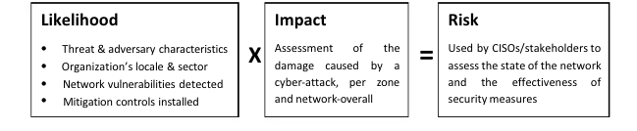
The eventual risk score factors both the likelihood and the impact of a cyber attack. Automated cyber-risk management:
Automated cyber-risk management incorporates multiple source for data on network topology, assets and vulnerabilities, adversaries and threat tactics, including:
Inventory mapping
Vulnerability mapping for likelihood scoring
Network and protocol diagrams

Slide 19
4. User and system behavior analysis
5. Peer Benchmarking
6. Virtual penetration testing (MITRE-ICS simulations)
Cyber Security Management System (CSMS):
The five fundamental elements of a CSMS program are:
High level risk assessment
Establish cyber security policy, awareness, and organization
Detailed risk assessment
Implement counter measures - mitigation controls
Continuously maintain and operate the CSMS program

Slide 20
Initial Risk Cyber Security Assessment (62443-3-2)
IEC 62443 prescribes that users identify the worst case unmitigated cyber security risk that could result from the interference with breach or disruption of or disablement of mission critical IACS operations.
For potentially hazardous processes, the results of the process hazard analysis (PHA) and functional safety assessments (as defined in IEC 61511-2) should be referenced as part of the initial cyber security risk assessment to identify worst-case impacts. The outcome of the initial level risk assessment is a defined set of zones and conduits in relation to impact the defined “impact zones” are assigned a security level target (SLT) dictates the security requirements(SR) needed to meet the SLT.

Slide 21
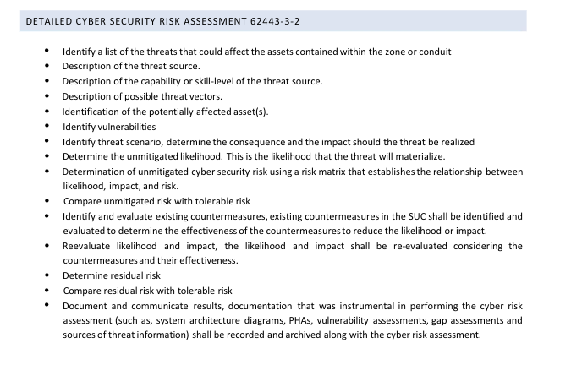

Slide 22
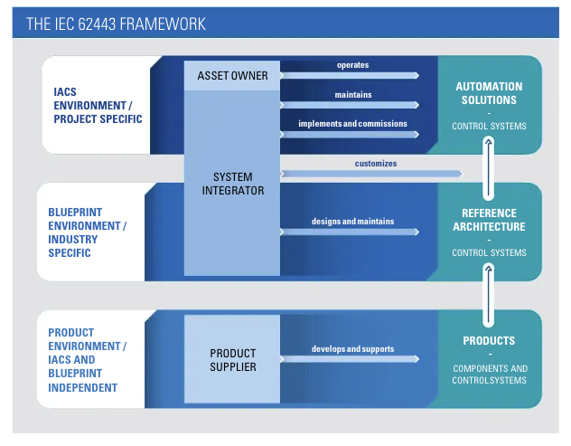

Slide 23
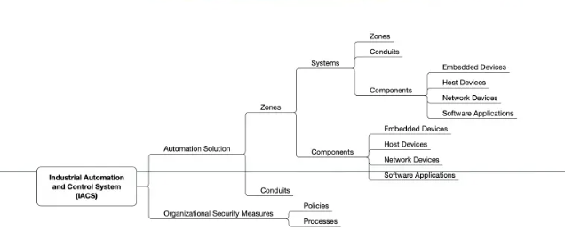
IACS Taxonomy

Slide 24
SilentDefense
SilentDefense is the most advanced and mature OT network monitoring and intelligence software. SilentDefense leverages the patented technology “Deep Protocol Behaviour Inspection” developed by SecurityMatters to passively analyses industrial network communications, provides rich information about network assets and alerts in real-time for any threat.
SilentDefense features several detection and analysis modules that allows end users to define the best analysis and detection strategy based on their requirements, including:
– Asset inventory and network map. Delivers full knowledge and awareness of your network through Silent Defense's automatic asset inventory and device fingerprinting features. Thanks to an advanced interactive network map users can understand device behavior, threats and vulnerabilities.
– Visual network analytics. End users can monitor in real-time network flows and industrial protocol operations through numerous graphs and widgets. End users can customize and filter views to analyze network activity and device behavior. It is possible to leverage historical data to perform visual forensic analysis.

Slide 25
– Network and protocol whitelists. This module automatically learns and validates network communication patterns and process operations with the most in-depth analysis of industrial protocols. It allows to identify rogue and malfunctioning devices, intrusions and attacks, and undesired configuration changes before they can affect the process. Unlike traditional machine learning algorithms, learned network models are fully editable and configurable
– Industrial Threat Library. End users can benefit from the knowledge and experience gained by SecurityMatters during hundred of deployments, and integrated into SilentDefense’s Industrial Threat Library, to detect out of the box and with no configuration effort hundreds of industry specific threats.

Slide 26
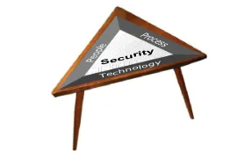
Change control and configuration management is
Particularly important to assuring the security integrity
Trust and confidence of the IACS. The seeming subtle
Configuration changes within the control systems components could be excluded from change control processes because they are quick to perform and are assumed to have limited, controllable effects. However, these same changes can have drastic effects on the operability, reliability, and vulnerabilities associated with the IACS. Using the people-process-technology triad as a methodology to resolve this problem the following strategies and solutions could be applied

Slide 27
Elements Applied to change control and configuration management
People :
Its is recommended that this subject is started first to have the greatest success.
Obtain senior management support that all IACS changes must be authorized and the adoption of security risk assessment into the change control process is required.
Identify those individuals in the organization who are accountable for ensuring their business unit address to the change control process.

Slide 28
Identify those responsible in the organization for supporting the change control process and their respective roles.
Communicate to and provide training to all participants of the change control process.
Processes:
This subject is started once strategies for “people” are in progress.
Document the appropriate policy that all staff and contractors must follow change control standards and procedures.
Identify and update all existing change control processes to include review of all IACS changes and evaluation of its security risks

Slide 29
Develop training programs and sessions on the new processes and procedures.
Monitor and audit the success the this new program and adjust as needed.
Technology:
Technology may be considered to improve productivity, efficiency and process consistency.
Develop technical requirements for the submission of change requests, evaluation, approval and evidence retention.
Migrate proven change control procedures and forms into the technology platform verify consistency with paper based methods.

Slide 30
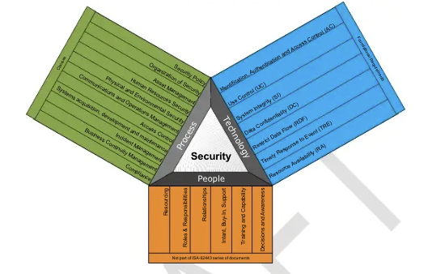
Implement technology to identify and track configuration changes of all IACS components, hardware and software.

Slide 31
Consequence based criteria
During all phases of the systems life cycle cybersecurity risk assessments shall include a determination of where and what could go wrong to disrupt IACS operations what is the likelihood that a cyber attack could initiate such a disruption and what are the consequences that could result. The output from this determination shall include sufficient information to help the ordinary user to identify and determine the relevant security properties.
The method determination shall include a decomposition of a system under consideration in accordance with the specifications in ISA 62443-3-2 and make visible the interaction between individual components. Functional relationships and the models used to translate the security strength of lower level components into aggregated measures shall be delineated to the degree necessary to determine the response action in accordance with the specifications in ISA 62443-1-3.

